Slide 1
Mini Project
Athlete Meet; a social network graph
By Sonaly Maharaj

Slide 2
Agenda
Social Network Graphs
What is Athlete Meet
How does Athlete Meet work
Purpose of Athlete Meet
Visualization of Athlete Meet
Information on Athlete Meet

Slide 3
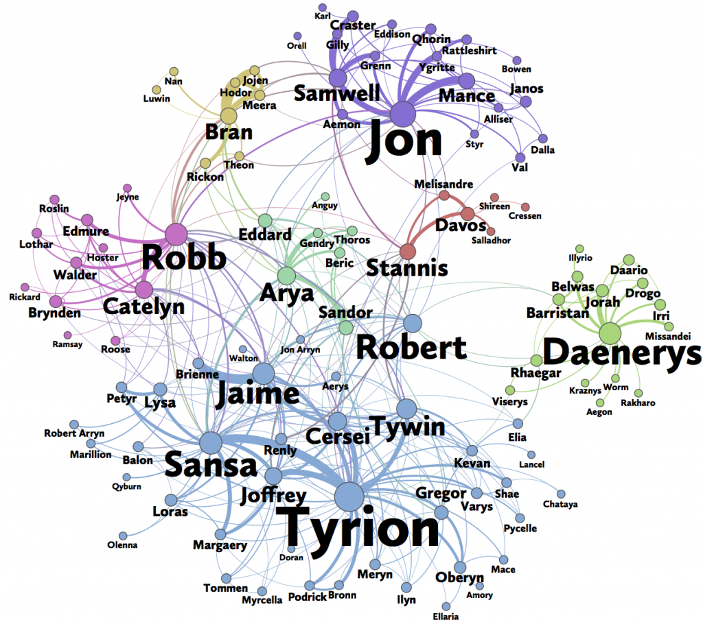
Social Network Graphs
A graph is a set of points joined by lines.
It can be used to describe/analyze social networks.
Lines represent diff relationships/ interactions.
There are many types of social network graphs.
Nodes represent users of a social network.

Slide 4
What is Athlete Meet?
Athletes can use this desktop app that is used to find other athletes with similar athletic qualities and interests as themselves.
The app presents possible mates to meet based on similarities between profiles and an identified valuable mate within that group of mates can be idolized.

Slide 5
How does Athlete Meet work?
Users can login/ signup using their athletic demographics (age, sport, team, fitness).
These users are stored in nodes.
Users can find other similar athletic mates on the app (e.g. same age).
These users are formed by attribute edges (relationships).
Users can view their social graph to view connections.
An MVP athletic member can be discovered within a group of nodes (fittest member).

Slide 6
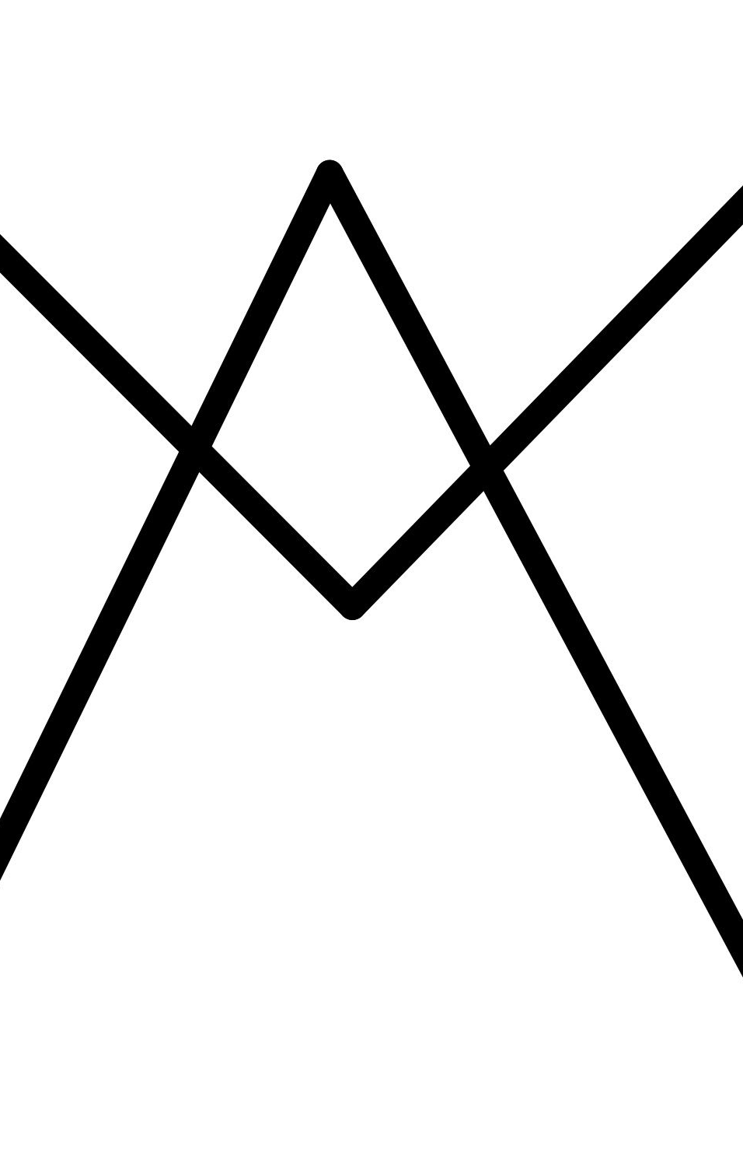
Purpose of Athlete Meet
Athletes may not have a means to find those with similar athletic ability, interests and qualities as themselves.
This app provides a means for users to connect with potential mates and identify the strongest of their group.
This allows users to find people to train with/ aspire to.
The app is meant for those interested in connecting with others based on sport and athletic ability..

Slide 7
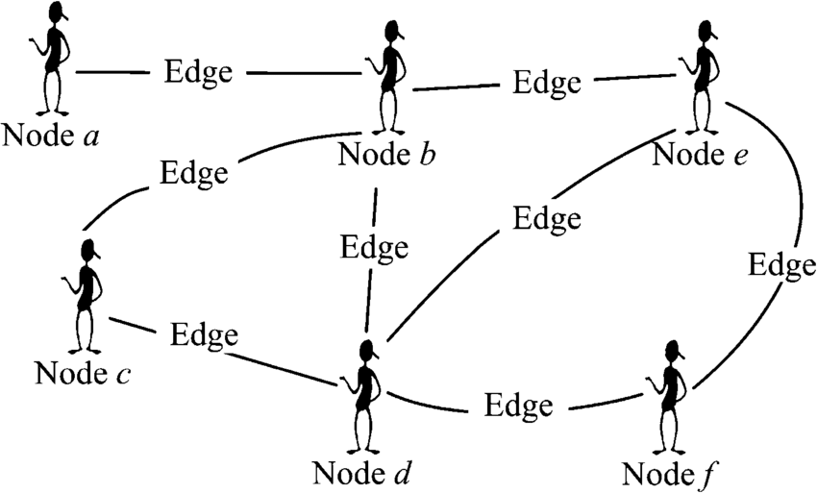
Information
Nodes = Athletes
Edges = Similar attributes
Cost of Edges = number of similar attributes
Attributes = age range, sport domain, supporting team, fitness level
Traversal = Fittest athlete within connections

Slide 8
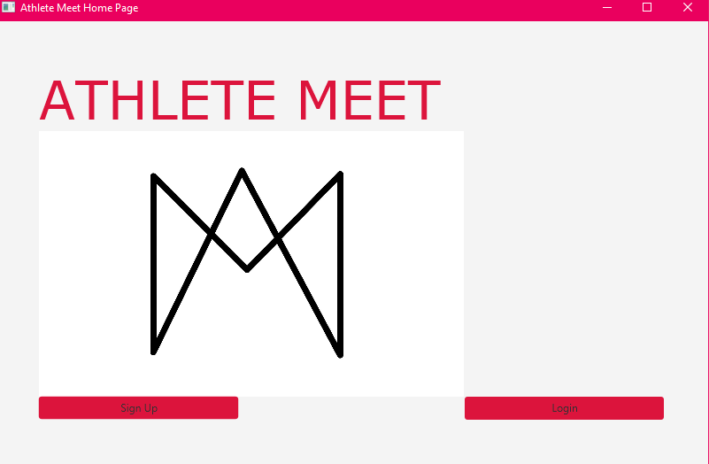
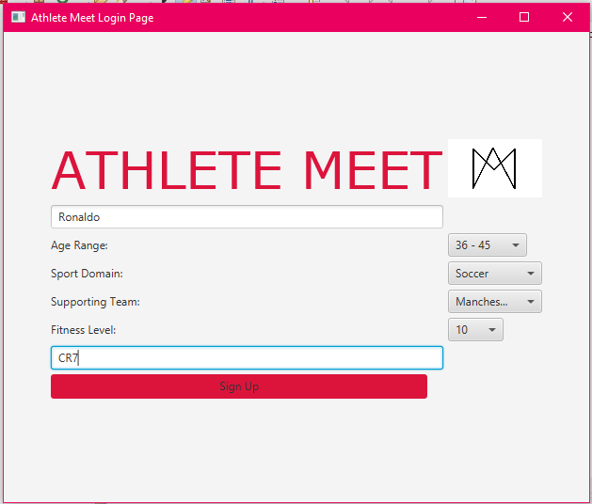
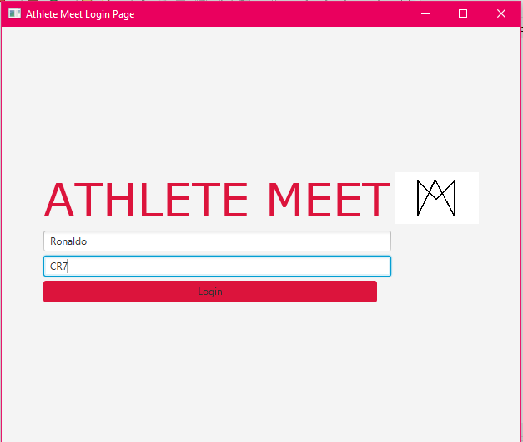
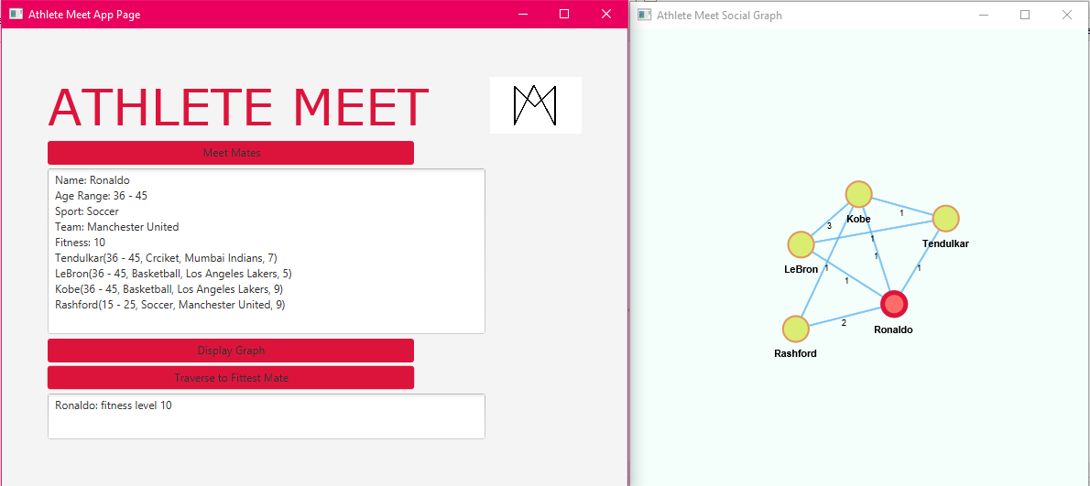
Demonstrating Athlete Meet

Slide 9

Thank You!

